Slide 1


Slide 2

14
MONOPOLISTIC COMPETITION
Notes:
Notes and teaching tips: 6, 8, 9, 14, 15, and 29.
To view a full-screen figure during a class, click the expand button.
To return to the previous slide, click the shrink button.
To advance to the next slide, click anywhere on the full screen figure.
Applying the principles of economics to interpret and understand the news is a major goal of the principles course. You can encourage your students in this activity by using the two features: Economics in the News and Economics in Action.
(1) Before each class, scan the news and select two or three headlines that are relevant to your session today. There is always something that works. Read the headline and ask for comments, interpretation, discussion. Pose questions arising from it that motivate today’s class. At the end of the class, return to the questions and answer them with the tools you’ve been explaining.
(2) Once or twice a semester, set an assignment, for credit, with the following instructions:
(a) Find a news article about an economic topic that you find interesting.
(b) Make a short bullet-list summary of the article.
(c) Write and illustrate with appropriate graphs an economic analysis of the key points in the article.
Use the Economics in the News features in your textbook as models.

Slide 3
After studying this chapter, you will be able to:
Define and identify monopolistic competition
Explain how a firm in monopolistic competition determines its price and output in the short run and the long run
Explain why advertising costs are high and why firms in monopolistic competition use brand names

Slide 4
What Is Monopolistic Competition?
Monopolistic competition is a market structure in which
A large number of firms compete.
Each firm produces a differentiated product.
Firms compete on product quality, price, and marketing.
Firms are free to enter and exit the industry.

Slide 5
What Is Monopolistic Competition?
Large Number of Firms
The large number of firms in the market implies that:
Each firm has a small market share and so limited market power to influence the price of its product.
Each firm is sensitive to the average market price but pays no attention to the actions of others. So no one firm’s actions directly affect the actions of others.
Collusion or conspiring to fix prices is impossible.

Slide 6
What Is Monopolistic Competition?
Product Differentiation
A firm in monopolistic competition practices product differentiation if the firm makes a product that is slightly different from the products of competing firms.
Notes:
Product differentiation—the heart of the space between monopoly and competition An old “ice cream on the beach” analogy really nails down the idea of product differentiation and explains how monopolistic competition fills the space between monopoly and perfect competition. Draw a line on the blackboard and label the two ends A and B. Tell the students that the line represents a beach (a long beach) along which beachgoers are uniformly spaced. An ice-cream vendor decides to set up shop on the beach—the only one. Where will she locate? The students will quickly see that the center—midway between A and B is the spot that will get the most customers because the cost of an ice cream is the market price plus the walking time to get it (remind them that the beach is very long!) Now a second ice-cream vendor opens up. Where does he locate? With a bit of help, the students will see that the best spot is right next to the first one. With one producer, there is monopoly and no variety—no product differentiation. With two producers, there is still no differentiation—technically, there is minimum differentiation. Now suppose a third and fourth ice-cream vendor come along. Where do they locate? At the ends of the beach at A and B. They differentiate as much as possible from each other and from the first two. Further entry has new ice-cream vendors locating in the middle of the gaps between the existing ones, always going into the widest gap. If the market could stand the competition, eventually, there would be ice-cream vendors so close to each other all along the beach that the members of any adjacent group were indistinguishable to a customer. Product differentiation would have been pushed to the point that there is no “space” for additional variety and the market would look like perfect competition.
Real products are like the beach example Talk about sports shoes, breakfast cereals, and any other goods that interest you and for which there are good locally observable examples and encourage the students to see that they are like the beach example. The variety of products fill the available variety “space.”

Slide 7
What Is Monopolistic Competition?
Competing on Quality, Price, and Marketing
Product differentiation enables firms to compete in three areas: quality, price, and marketing.
Quality includes design, reliability, and service.
Because firms produce differentiated products, the demand for each firm’s product is downward sloping. But there is a tradeoff between price and quality.
Because products are differentiated, a firm must market its product. Marketing takes the two main forms: advertising and packaging.

Slide 8
What Is Monopolistic Competition?
Entry and Exit
There are no barriers to entry in monopolistic competition, so firms cannot make an economic profit in the long run.
Examples of Monopolistic Competition
Producers of audio and video equipment, clothing, jewelry, computers, and sporting goods operate in monopolistic competition.
Notes:
Classroom activity
Check out Economics in Action: Monopolistic Competition Today

Slide 9
Price and Output in Monopolistic Competition
The Firm’s Short-Run Output and Price Decision
A firm that has decided the quality of its product and its marketing program produces the profit-maximizing quantity (the quantity at which MR = MC).
Price is determined from the demand for the firm’s product and the highest price that the firm can charge for the profit-maximizing quantity.
Figure 14.1 shows a firm’s economic profit in the short run.
Notes:
The demand for a firm’s differentiated product in monopolistic competition
Remind the students about the ceteris paribus condition that defines a demand curve. Along the demand curve for Nike tennis shoes, the prices of Adidas, Fila, Head, K Swiss, Prince, Reebok, and Wilson tennis shoes are constant. Some people prefer Nike to the other brands and will pay a bit more for Nike. Other people prefer some other brand and will buy Nike only if its price is low enough. Buyers have brand preferences, but they will switch brands if price differences are large enough. So the higher the price of a Nike shoe, the prices of the other brands remaining the same, the smaller is the quantity of Nike shoes demanded.

Slide 10
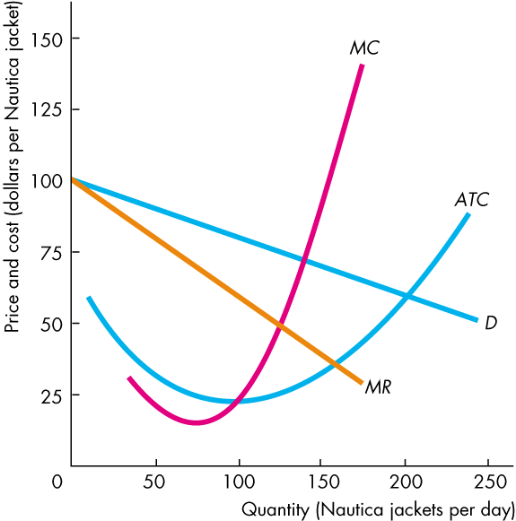
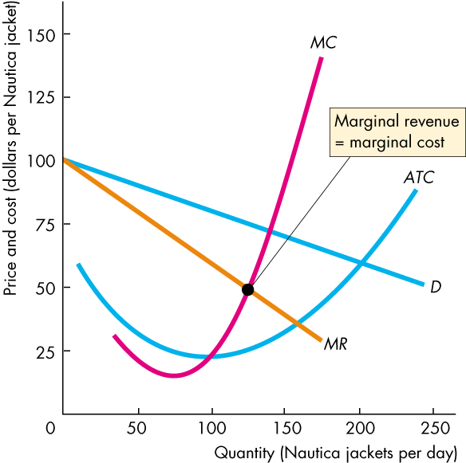
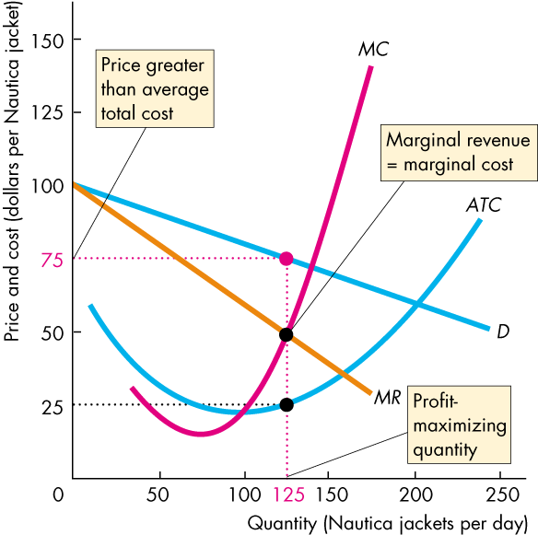
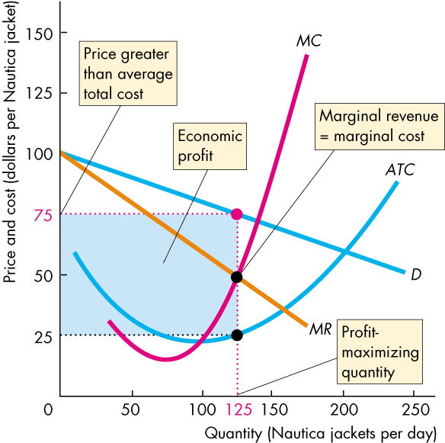

Price and Output in Monopolistic Competition
The firm in monopolistic competition operates like a single-price monopoly.
The firm produces the quantity at which MR equals MC and sells that quantity for the highest possible price.
It makes an economic profit (as in this example) when P > ATC.

Slide 12
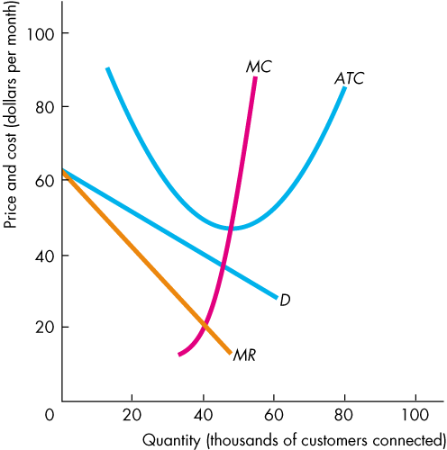
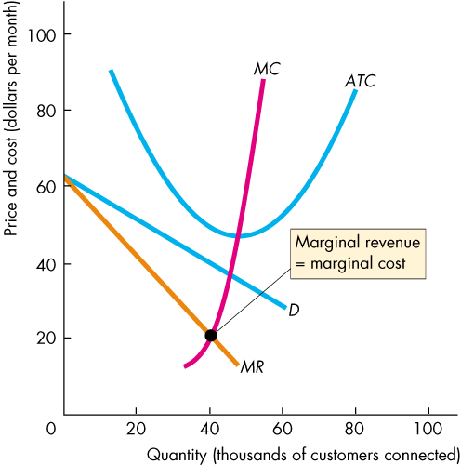
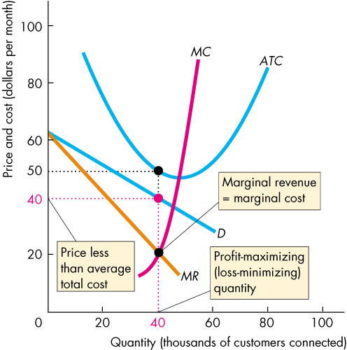
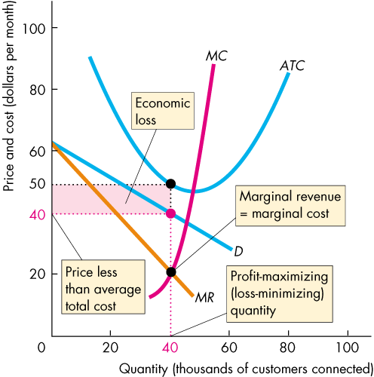
Price and Output in Monopolistic Competition
Profit Maximizing Might Be Loss Minimizing
A firm might incur an economic loss in the short run.
Here is an example.
At the profit-maximizing quantity, P < ATC and the firm incurs an economic loss.

Slide 14
Price and Output in Monopolistic Competition
Long Run: Zero Economic Profit
In the long run, economic profit induces entry.
And entry continues as long as firms in the industry make an economic profit—as long as (P > ATC).
In the long run, a firm in monopolistic competition maximizes its profit by producing the quantity at MR = MC.
Notes:
Classroom activity
Check out Economics in the News: Product Differentiation in Smartphones

Slide 15
Price and Output in Monopolistic Competition
As firms enter the industry, each existing firm loses some of its market share.
The demand for its product decreases.
The decrease in demand decreases the quantity at which MR = MC and lowers the maximum price that the firm can charge to sell this quantity.
As new firms enter, the firm's price and quantity fall until P = ATC and each firm earns zero economic profit.
Notes:
Entry and exit shift the demand curve for a firm’s product
Students seem to have a bit of trouble appreciating that entry and exit change the demand for a firm’s product. Explain this effect by sticking with the tennis shoes example. Explain that the demand for Nike tennis shoes changes and the demand curve for Nike tennis shoes shifts if other firms enter or exit. If Tommy Hilfiger and the Gap started to make tennis shoes, some of Nike’s former customers would switch to these two new brands, and the demand for Nike shoes would decrease. The demand curve for Nike shoes would shift leftward. If Adidas, Fila, and Reebok stopped making tennis shoes, some of their former customers would switch to Nike, and the demand for Nike shoes would increase. The demand curve for Nike shoes would shift rightward.

Slide 16
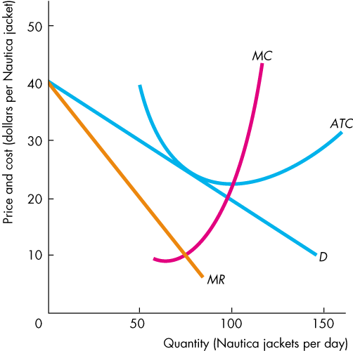
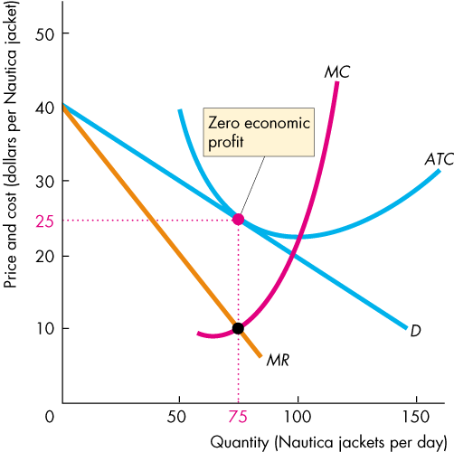
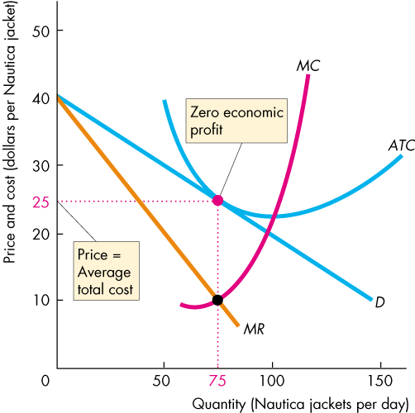
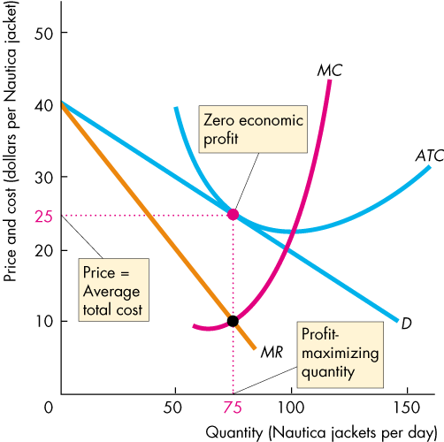
Price and Output in Monopolistic Competition
Figure 14.3 shows a firm in monopolistic competition in long-run equilibrium.

Slide 18
Price and Output in Monopolistic Competition
Monopolistic Competition and Perfect Competition
Two key differences between monopolistic competition and perfect competition are
Excess capacity
Markup
A firm has excess capacity if it produces less than the quantity at which ATC is a minimum.
A firm’s markup is the amount by which its price exceeds its marginal cost.

Slide 19
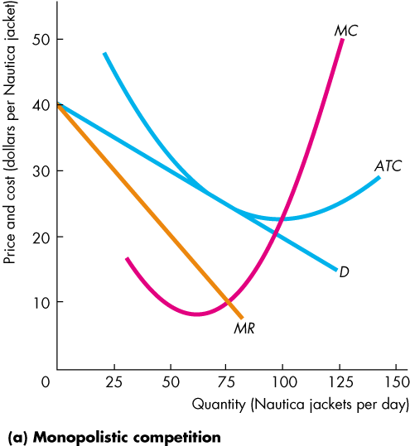
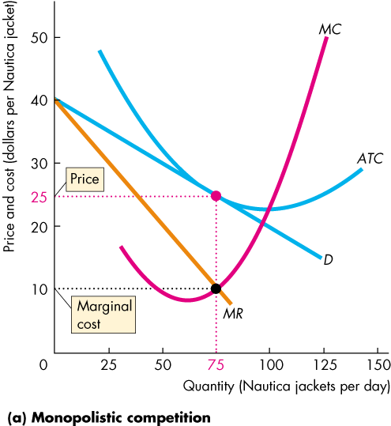
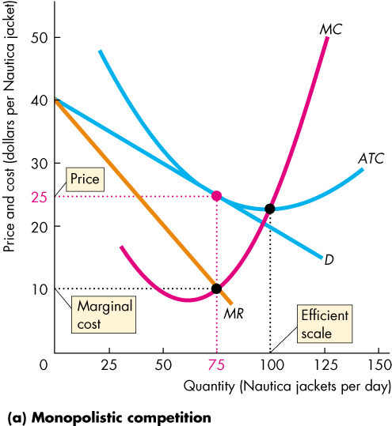
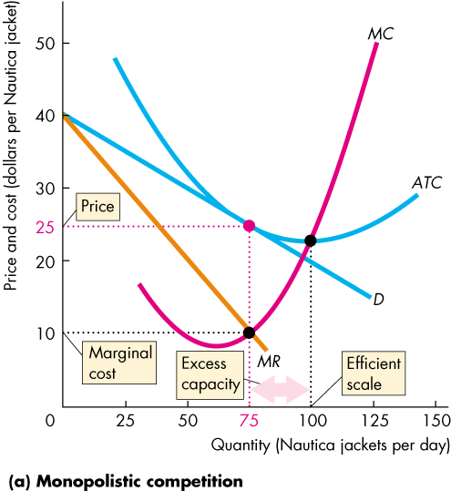
Price and Output in Monopolistic Competition
In long-run equilibrium, firms in monopolistic competition produce less than the efficient scale—the quantity at which ATC is a minimum.
They operate with excess capacity.
The downward-sloping demand curve for their products drives this result.

Slide 20
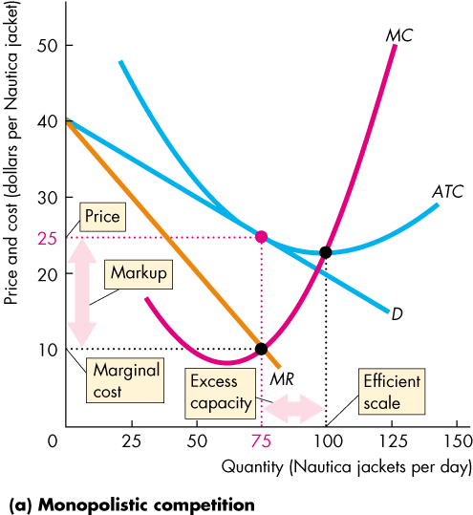

Slide 21
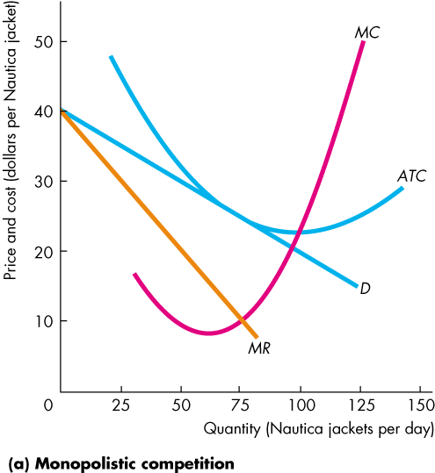
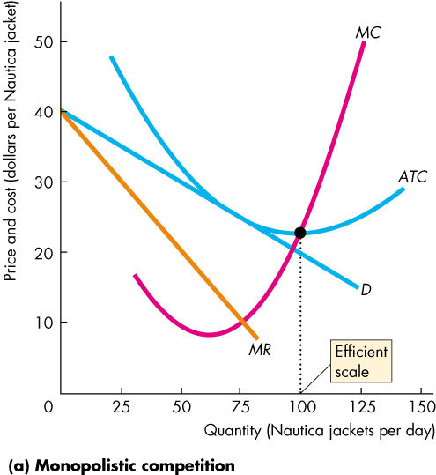
Price and Output in Monopolistic Competition
Firms in monopolistic competition operate with positive markup.
Again, the downward-sloping demand curve for their products drives this result.

Slide 22
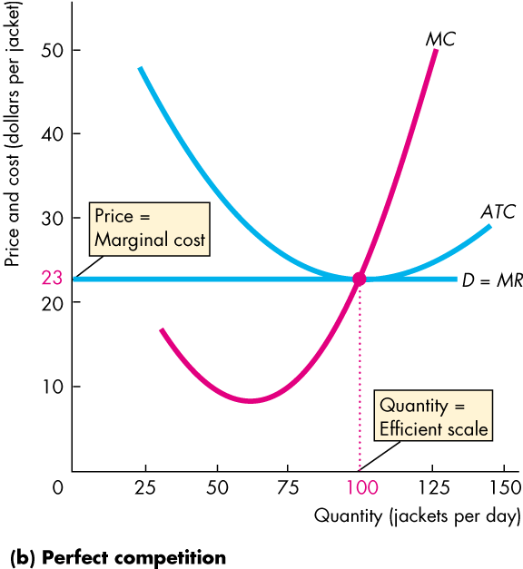
Price and Output in Monopolistic Competition
In contrast, firms in perfect competition have no excess capacity and no markup.
The perfectly elastic demand curve for their products drives this result.

Slide 24
Price and Output in Monopolistic Competition
Is Monopolistic Competition Efficient?
Price equals marginal social benefit.
The firm’s marginal cost equals marginal social cost.
Because price exceeds marginal cost, marginal social benefit exceeds marginal social cost, so ...
in the long run, the firm in monopolistic competition produces less than the efficient quantity.

Slide 25
Price and Output in Monopolistic Competition
Making the Relevant Comparison
The markup (price minus marginal cost) arises from product differentiation.
People value product variety, but product variety is costly.
The efficient degree of product variety is the one for which the marginal social benefit from product variety equals its marginal social cost.
The loss that arises excess capacity is offset by the gain that arises from having a greater degree of product variety.

Slide 26
Product Development and Marketing
Product Development
We’ve looked at a firm’s profit-maximizing output decision in the short run and in the long run, for a given product and with given marketing effort.
To keep making an economic profit, a firm in monopolistic competition must be in a state of continuous product development.
New product development allows a firm to gain a competitive edge, if only temporarily, before competitors imitate the innovation.

Slide 27
Product Development and Marketing
Innovation is costly, but it increases total revenue.
Firms pursue product development until the marginal revenue from innovation equals the marginal cost of innovation.
The amount of production development is efficient if the marginal social benefit from an innovation (which is the amount the consumer is willing to pay for the innovation) equals the marginal social cost that firms incur to make the innovation.

Slide 28
Product Development and Marketing
Advertising
A firm with a differentiated product needs to ensure that customers know that its product differs from its competitors.
Firms use advertising and packaging to achieve this goal.
A large proportion of the price we pay for a good covers the cost of selling it.
Advertising expenditures affect the firm’s profit in two ways: They increase costs, and they change demand.

Slide 29
Product Development and Marketing
Selling Costs and Total Costs
Selling costs, such as advertising expenditures, fancy retail buildings, etc. are fixed costs.
Average fixed costs decreases as output increases, so selling costs increase average total cost at any given quantity but do not change marginal cost.
Selling Costs and Demand
Successful advertising increases the demand for the firm’s product.
But if all firms advertise and new firms enter, the demand for any firm’s product will decrease.
Notes:
Classroom activity
Check out Economics in Action: The Cost of Selling a Pair of Shoes

Slide 30
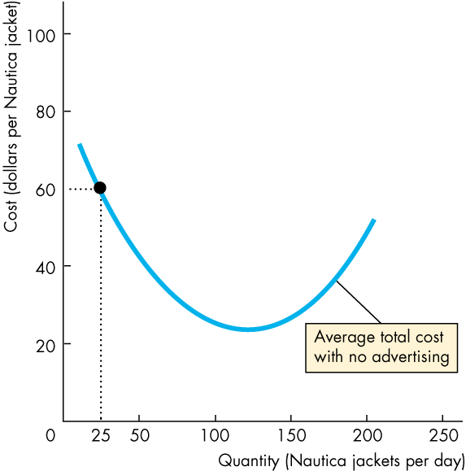
Product Development and Marketing
With no advertising, this firm produces 25 units of output at an average total cost of $60.
Advertising costs might lower the average total cost by increasing the quantity produced and spreading their fixed costs over the larger output.

Slide 31
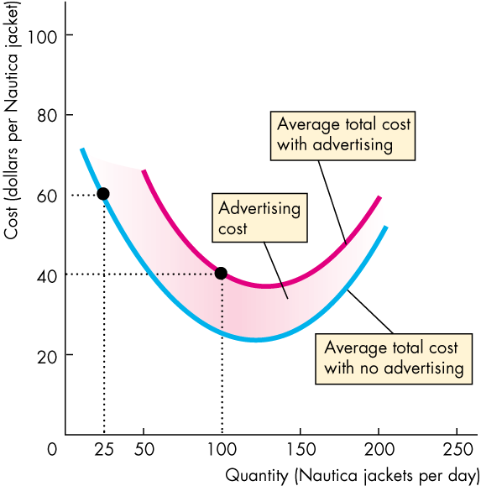
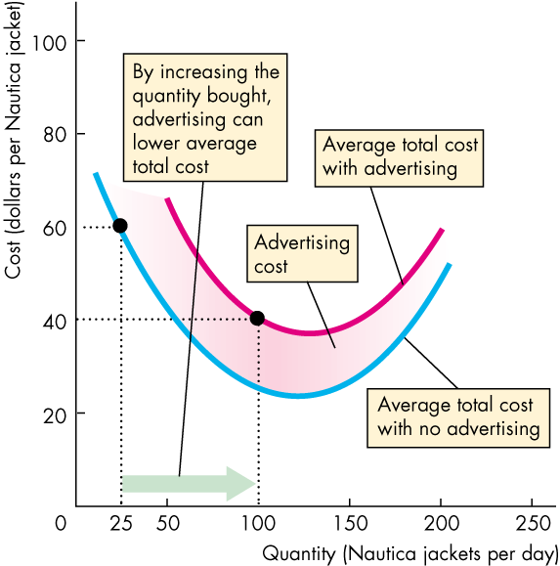
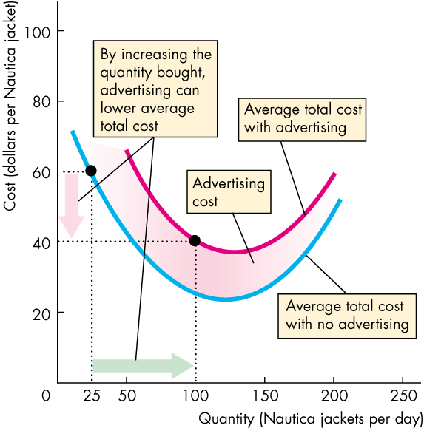

Slide 32
Product Development and Marketing
With advertising, the firm can produce 100 units of output at an average total cost of $40.
Advertising expenditure shifts the ATC curve upward, but …
the firm operates at a larger output and lower average total cost than it would without advertising.

Slide 33
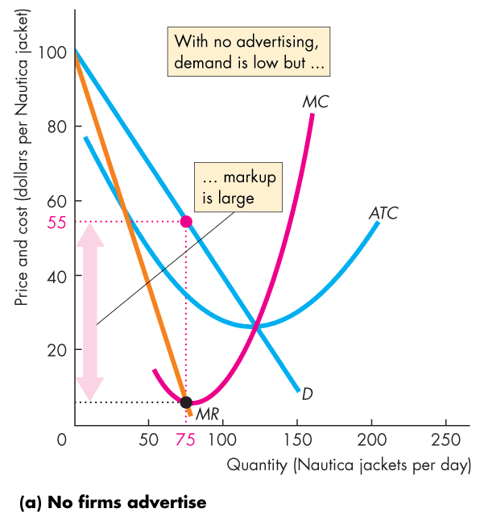
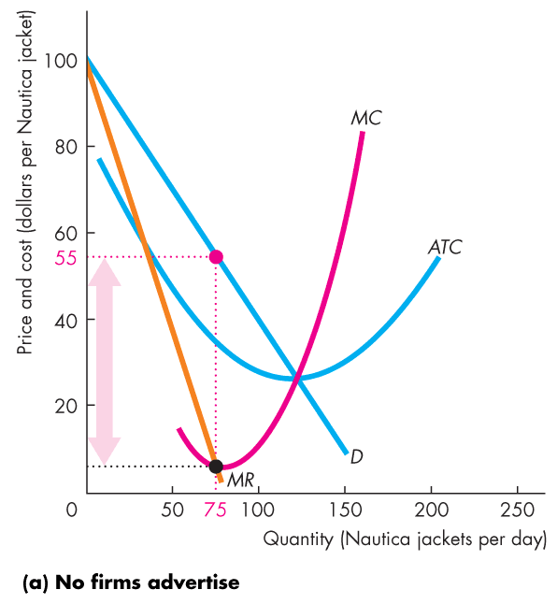
Product Development and Marketing
Advertising might also shrink the markup.
Figure 14.6(a) shows that with no advertising, the demand for a firm’s output is not very elastic and its markup is large.

Slide 34
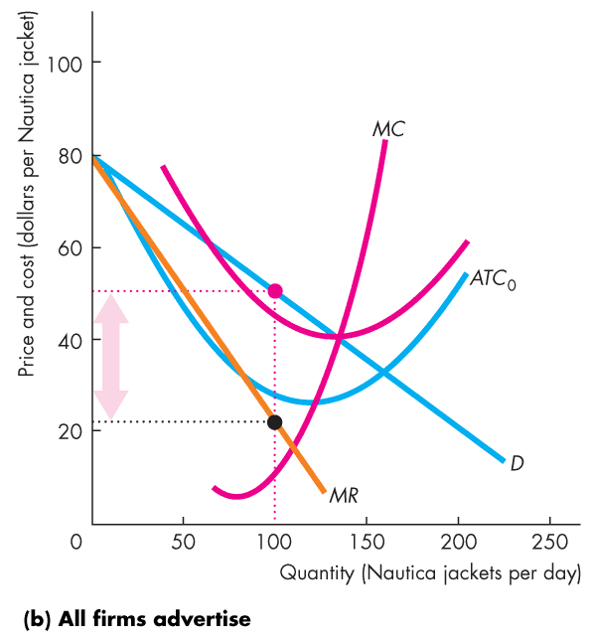
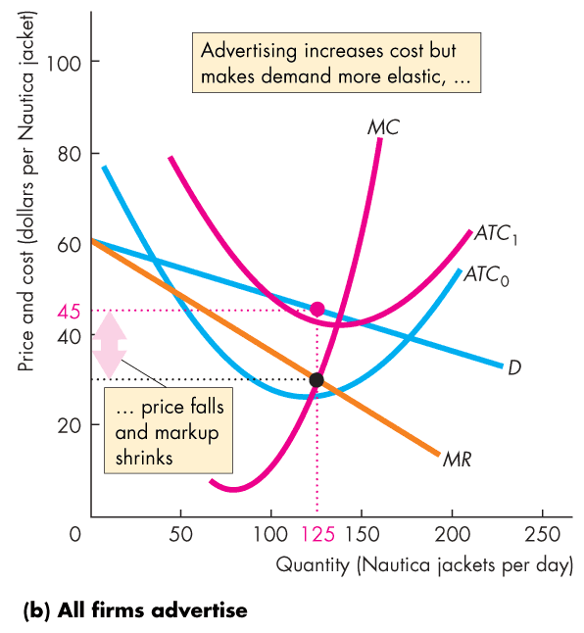

Slide 35
Product Development and Marketing
Figure 14.6(b) shows that if all firms advertise, the demand for a firm’s output becomes more elastic.
The firm produces a larger quantity, its price falls, and its markup shrinks.

Slide 36
Product Development and Marketing
Using Advertising to Signal Quality
Why do Coke and Pepsi spend millions of dollars a month advertising products that everyone knows?
One answer is that these firms use advertising to signal the high quality of their products.
A signal is an action taken by an informed person or firm to send a message to uninformed people.

Slide 37
Product Development and Marketing
Coke is a high quality cola, and Oke is a low quality cola.
If Coke spends millions on advertising, people think “Coke must be good.”
If it is truly good, when they try it, they will like it and keep buying it.
If Oke spends millions on advertising, people will think “Oke must be good.”
If it is truly bad, when they try it, they will hate it and stop buying it.

Slide 38
Product Development and Marketing
So if Oke knows its product is bad, it will not bother to waste millions advertising it.
And if Coke knows its product is good, it will spend millions advertising it.
Consumers will read the signals and get the correct message.
None of the ads need to mention the product. They just need to be flashy and expensive.

Slide 39
Product Development and Marketing
Brand Names
Why do firms spend millions of dollars to establish a brand name or image?
Again, the answer is to provide information about quality and consistency.
You’re more likely to overnight at a Holiday Inn than at Joe’s Motel because Holiday Inn has incurred the cost of establishing a brand name and you know what to expect if you stay there.

Slide 40
Product Development and Marketing
Efficiency of Advertising and Brand Names
To the extent that advertising and selling costs provide consumers with information and services that they value more highly than their cost, these activities are efficient.

